Slide 1
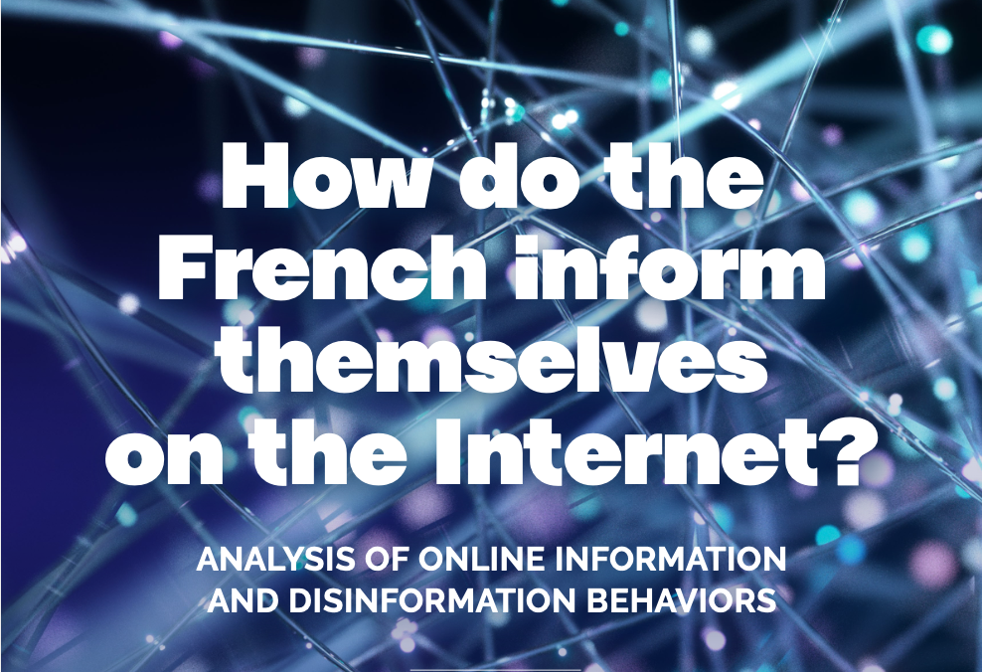
Study by the Fondation Descartes
March 2021

Slide 2
The Fondation Descartes
Our organization
About us
The Fondation Descartes is an interdisciplinary think-tank dedicated to the challenges related to information, disinformation and public debate. Founded in 2019 and based in Paris, it is a non-partisan, independent, citizen-based and European initiative.
Executive Board
9 members
President: Jean-Philippe Hecketsweiler
President of the Fondation Descartes
Scientific Committee
6 members
President: Gérald Bronner
Professor of Sociology, University of Paris
Our mission
To contribute to research and reflection on issues related to information and public debate in the age of the Internet and social networks, and to promote the need for sincere information for a democracy based on trust.
Research Team
Director: Laurent Cordonier
PhD in Social Sciences
The Fondation Descartes is established in the form of an Endowment Fund under French law. It is financed by private contributions.
Website of the Fondation Descartes: www.fondationdescartes.org

Slide 3
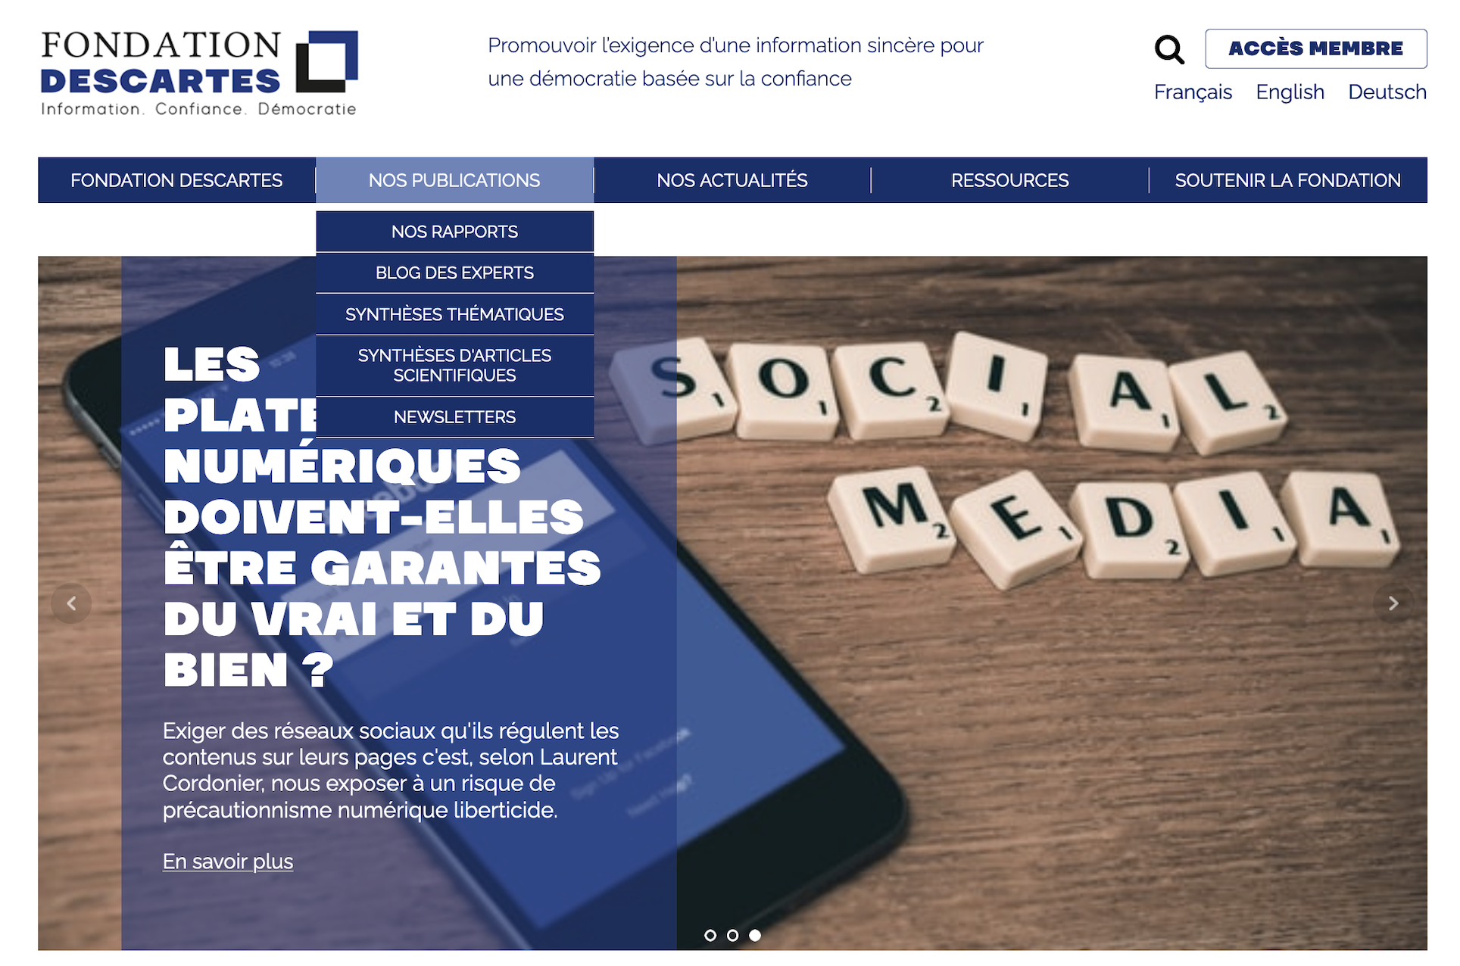
The Fondation Descartes
Find our publications at www.fondationdescartes.org

Slide 4
The Study
“How do the French inform themselves on the Internet?”
Goals of the study
Understand the way in which the French consume news information on the Internet
Overcome certain methodological limitations of existing studies on this topic, by distinguishing behaviors and attitudes.

Slide 5
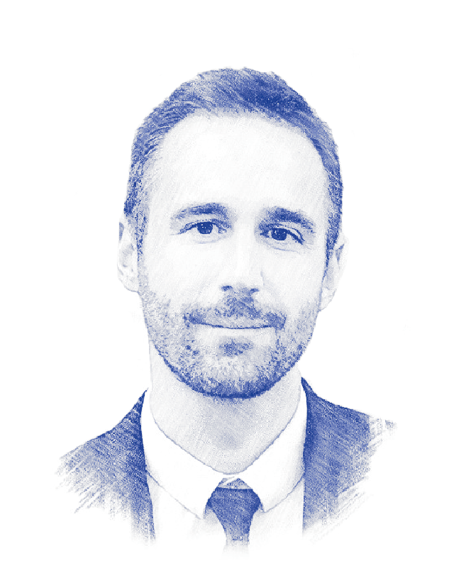
The Study
Study Authors
Laurent Cordonier, PhD in Social Sciences, is a researcher at the Fondation Descartes, coordinator of its Scientific Committe and associate researcher at the University of Paris
Contact: lc@fondationdescartes.org
Aurélien Brest, holder of a master’s degree in Cognitive Sciences, is a researcher at the Fondation Descartes
Contact: ab@fondationdescartes.org

Slide 6
The Study
Methodological limitations of existing studies
Behavioral method
Measure of traffic on online information sources (for ex., Médiamétrie)
Declarative method
Survey of information habits (for ex., Reuters)
Who are the individuals that make up the traffic?
Do the declarations correspond to effective behavior?

Slide 7
The Study
An innovative hybrid approach
Hybrid approach Fondation Descartes
Measure of the traffic of a panel
+
Survey of this panel
Behavioral procedure
Measure of traffic on online information sources (for ex., Médiamétrie.)
Declarative procedure
Survey of information habits (for ex., Reuters)

Slide 8
Methodology
An innovative hybrid approach
2,372 individuals tracked
Panel that is representative of the French population aged 18 and over
Recording of Internet activity on all connected personal devices (computer, smartphone, tablet) by the company Respondi.
30 days
Duration of the study
September 20 to October 19, 2020
Broad spectrum of information sources
National, regional and local print media, TV channels, radio stations, women’s and men’s magazines, sports, celebrity and lifestyle news, digital-only media, blogs, “alternative” media, etc.
2,946 online French-language
information sources were tracked

Slide 9
Methodology
2,946 information sources classified according to their reliability
2,946 information sources identified by the company Storyzy
2,295 websites
> 15,000 visitors*
+ their associated mobile applications, Facebook and Twitter pages and YouTube channels
651 YouTube channels unrelated to the tracked websites
> 15,000 subscribers*
Reliable
Unreliable
Classification according to Storyzy’s algorithm
Comparison of this classification with that of the Décodeurs of Le Monde
* in the month preceding the study

Slide 10
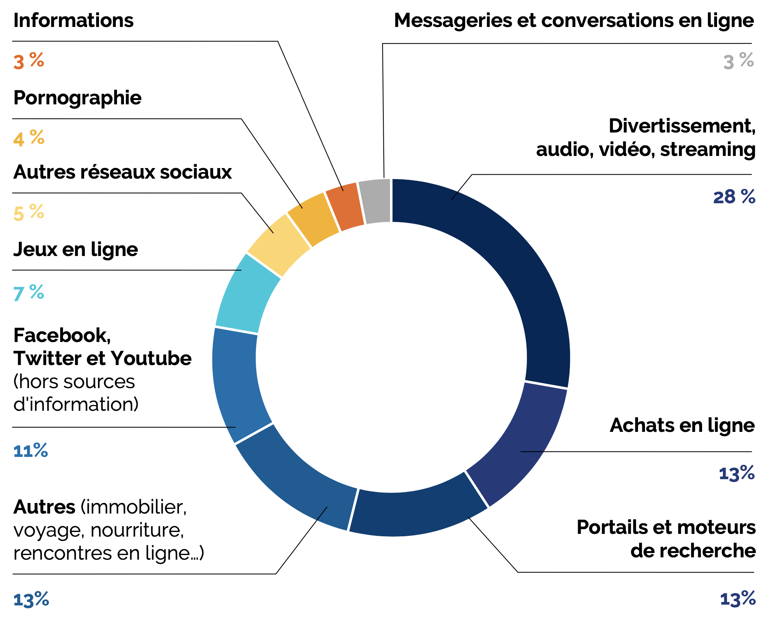
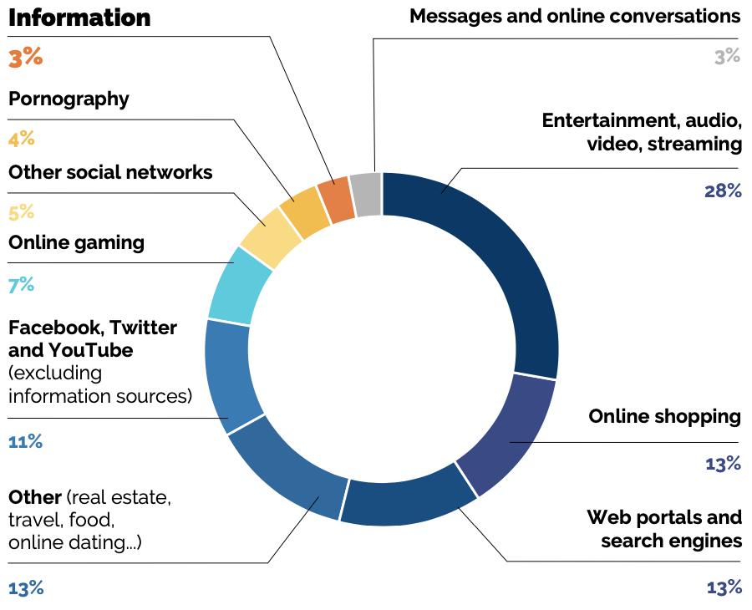
Results
The French spend 3% of their connected time consuming information
Distribution of connected time
The French spend on average 3% of their connected time consulting online information sources
Or 4.9 minutes per connected day

Slide 11
Results
Internet, the second information access channel of the French
Share of the French population that reports informing themselves everyday via …
4.9 min average daily time spent consuming information on the Internet
20 min daily individual listening time of major TV newscasts¹
¹ “Youth and Information,” 2018 press release, Médiamétrie and
the Ministry of Culture

Slide 12
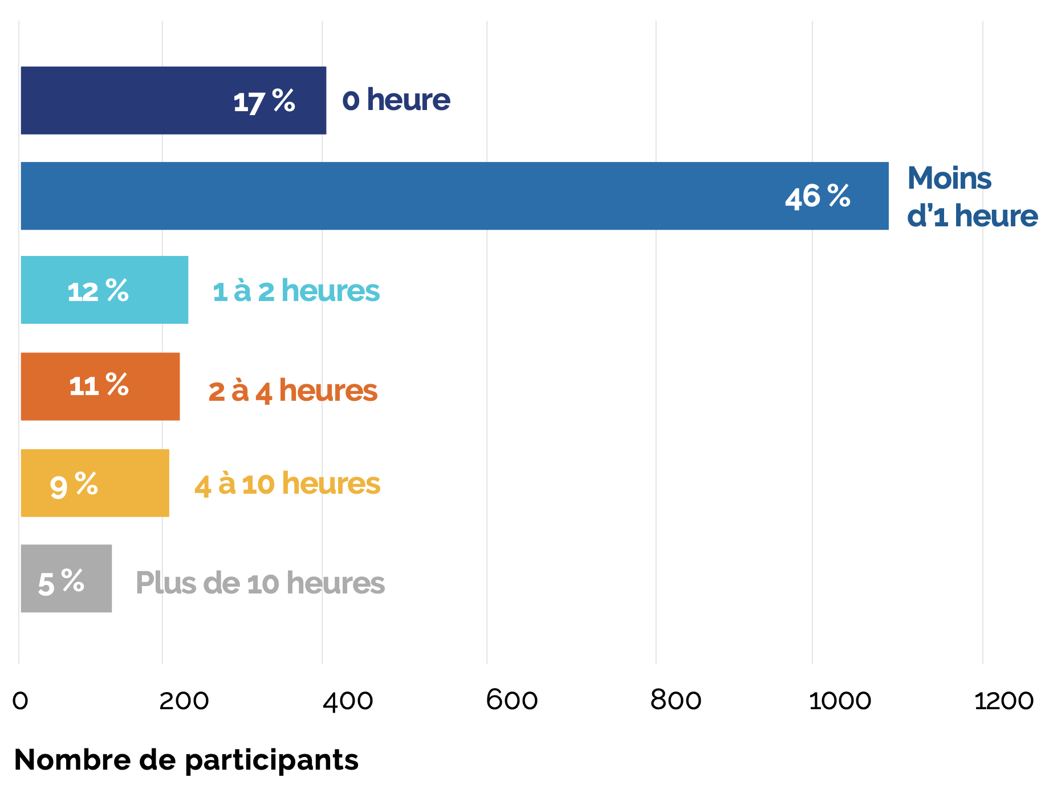
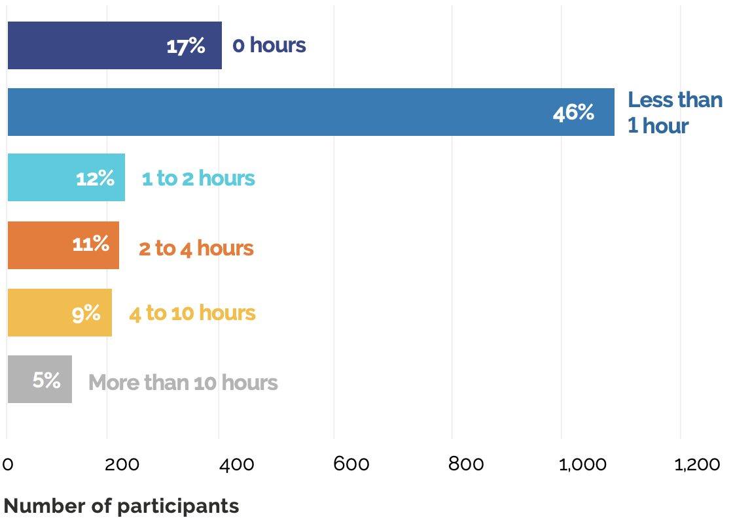
Results
Time dedicated to information varies greatly
Total number of hours spent consulting information sources during the study’s 30-day period
17% of participants consulted no information sources on the Internet
5% of participants spent more than 10 hours informing themselves online
Individuals 50 and over inform themselves more than others on the Internet

Slide 13
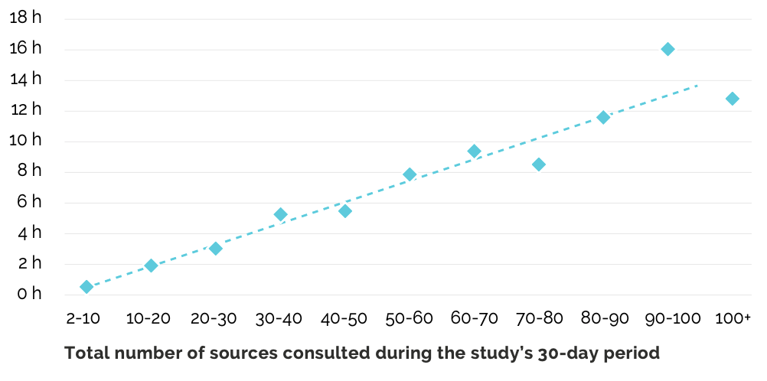
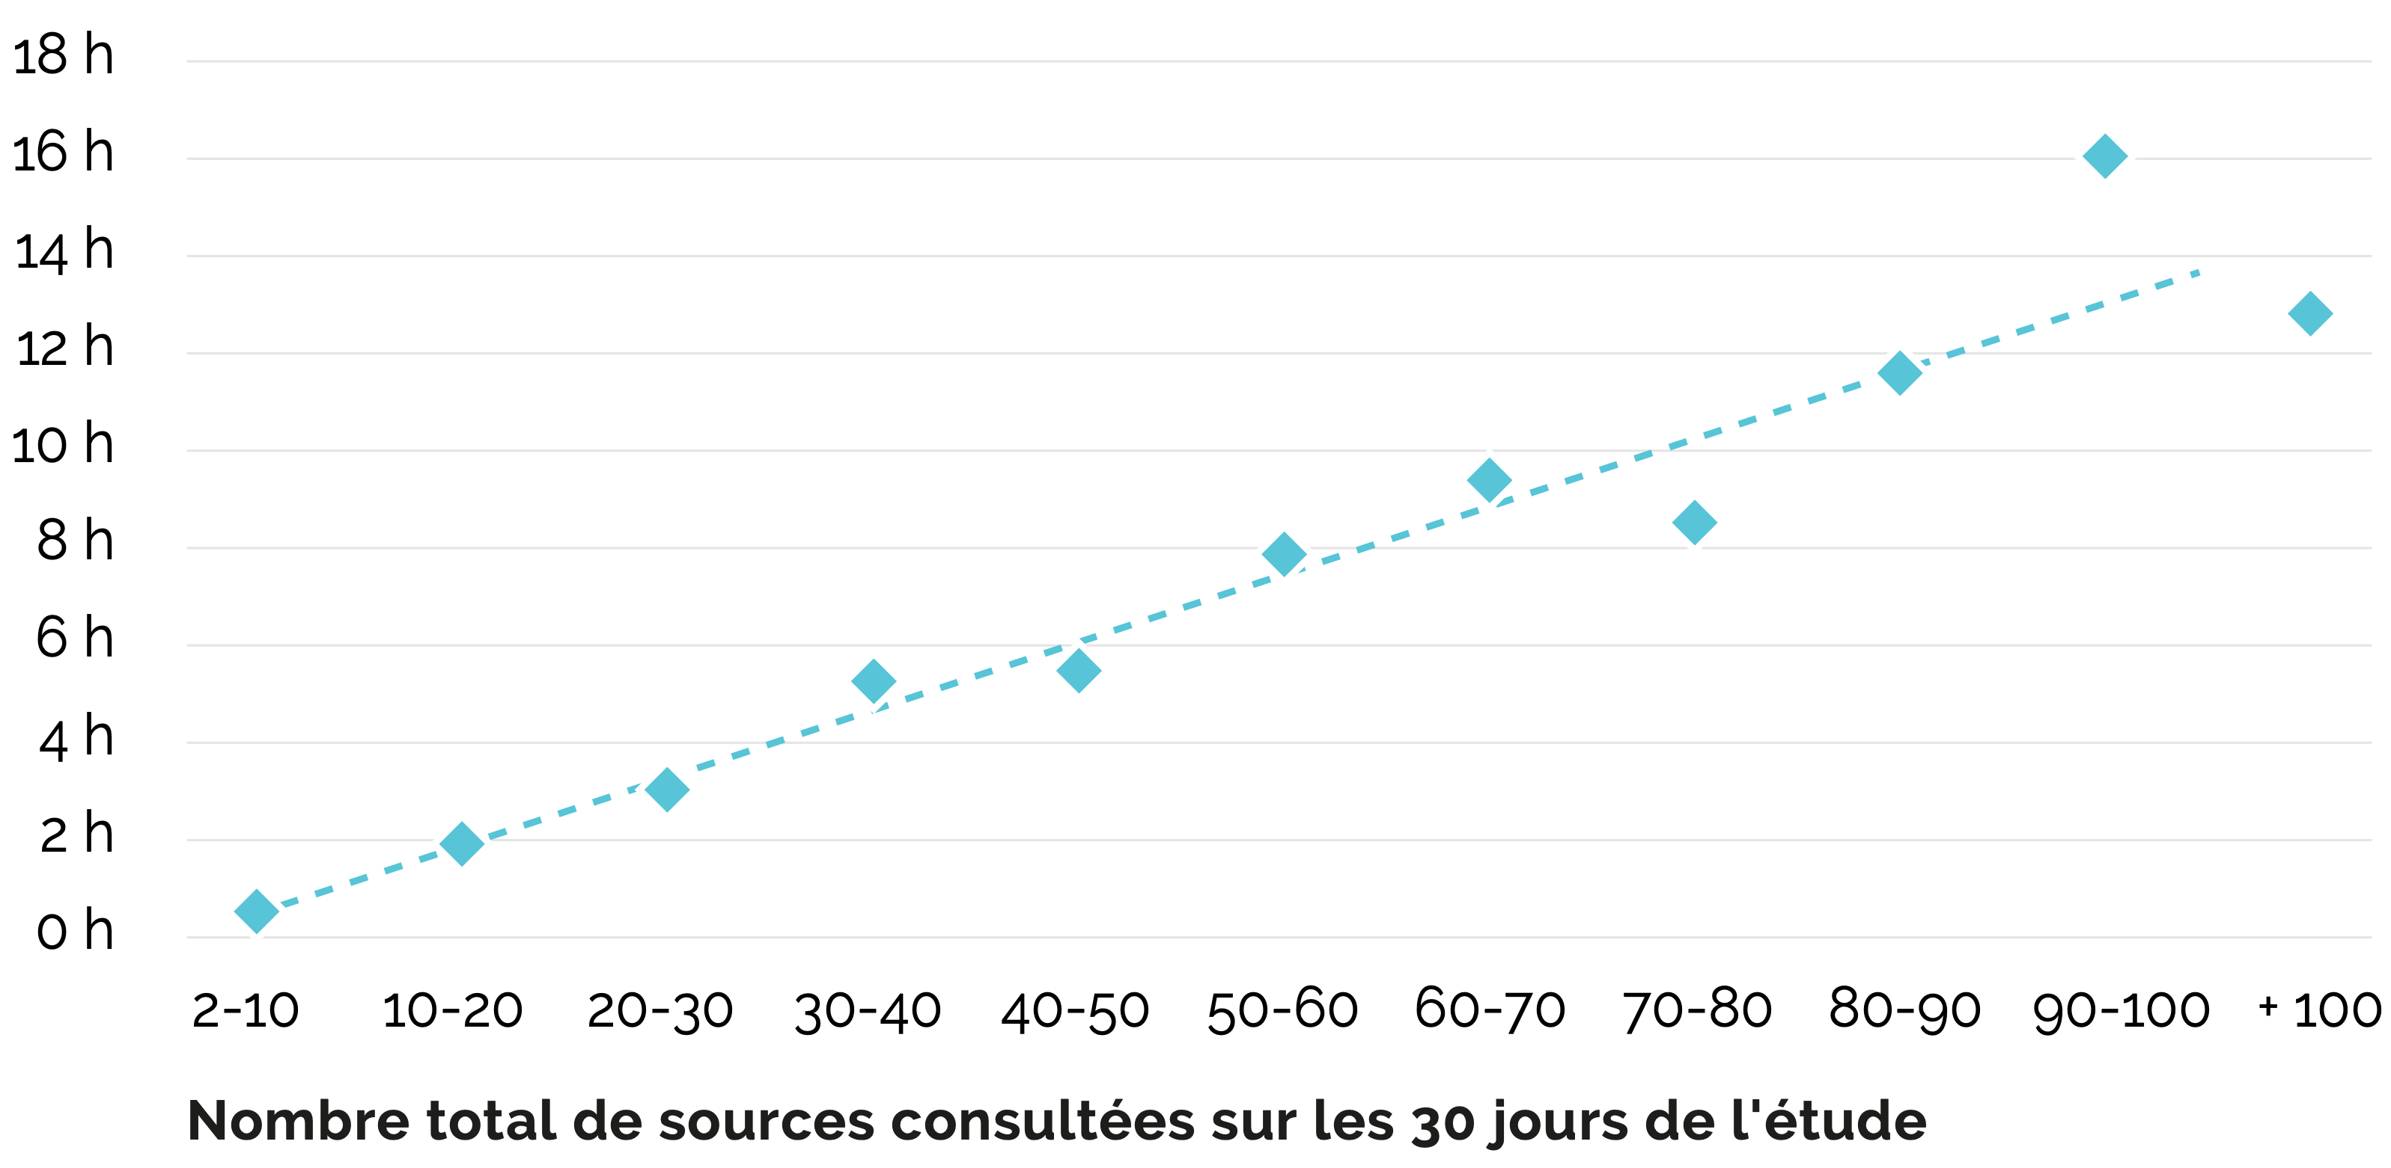
Results
A “browsing” behavior on the Internet
Relationship between time spent on information and the number of information sources consulted
An increase in information time results in an increase in the number of sources consulted
1.9 minutes the average duration of consultation of each information source per visit
15 the average number of different information sources consulted throughout the study period
Graph Reading: there exists a quasi-linear relationship between the average time spent consuming online information and the number of different information sources consulted.
Participants who consulted 2 to 10 different information sources during the study’s 30-day period spent on average 0.74 hours informing themselves online. Those who consulted 90 to 100 different information sources spent on average 16.01 informing themselves online.

Slide 14
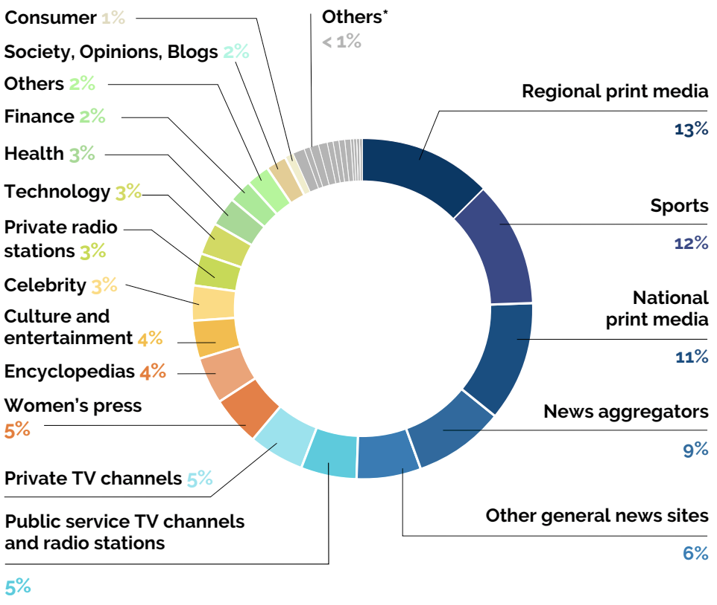
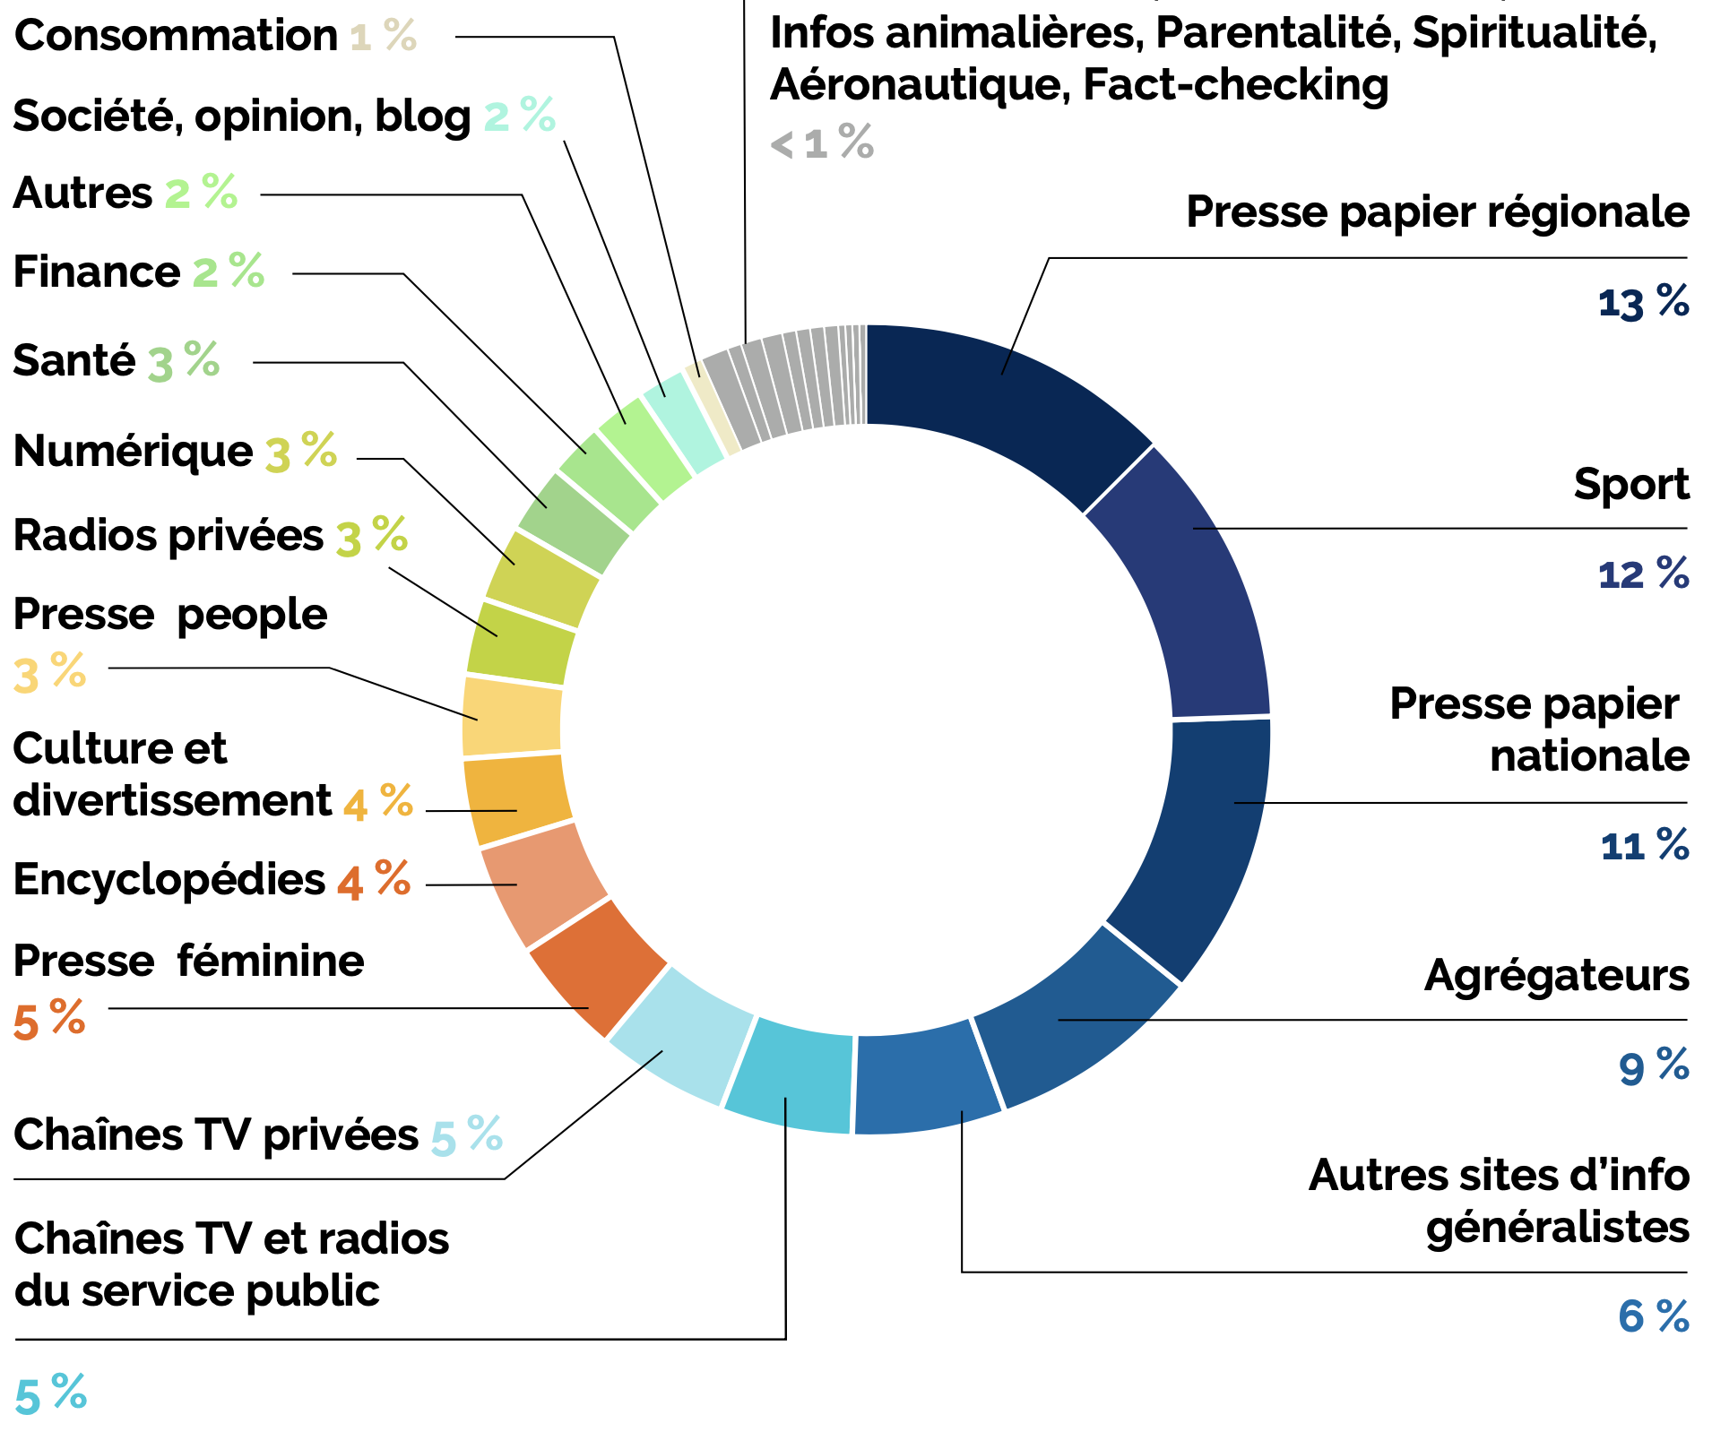
Results
Regional print media is dominant on the web
Types of information sources consulted
Autres (par catégories)
The online information sources most consulted
Regional print media
Sports news
National print media

Slide 15
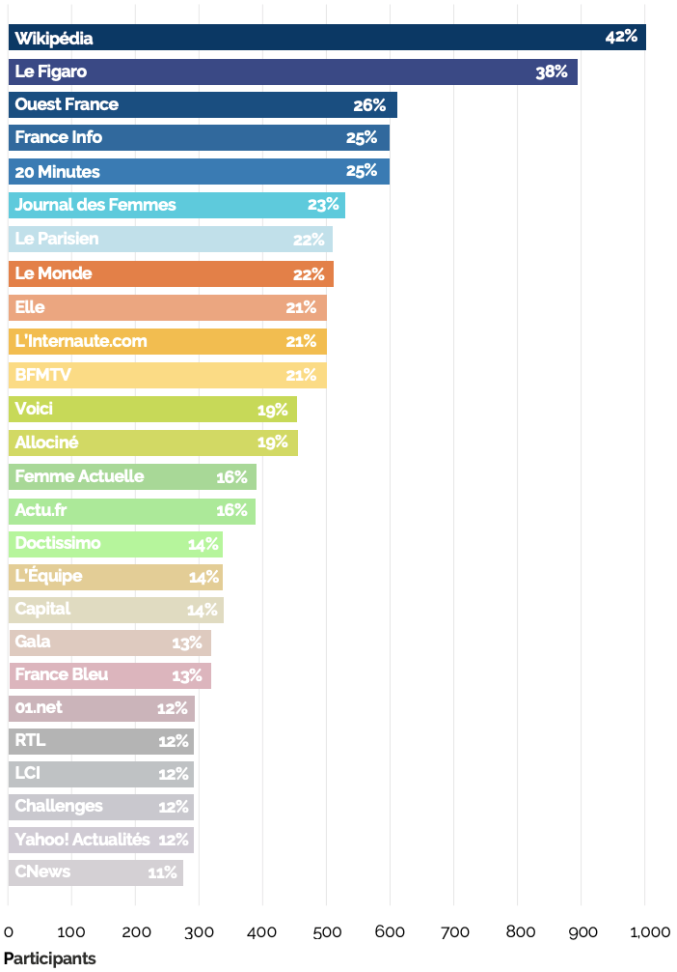
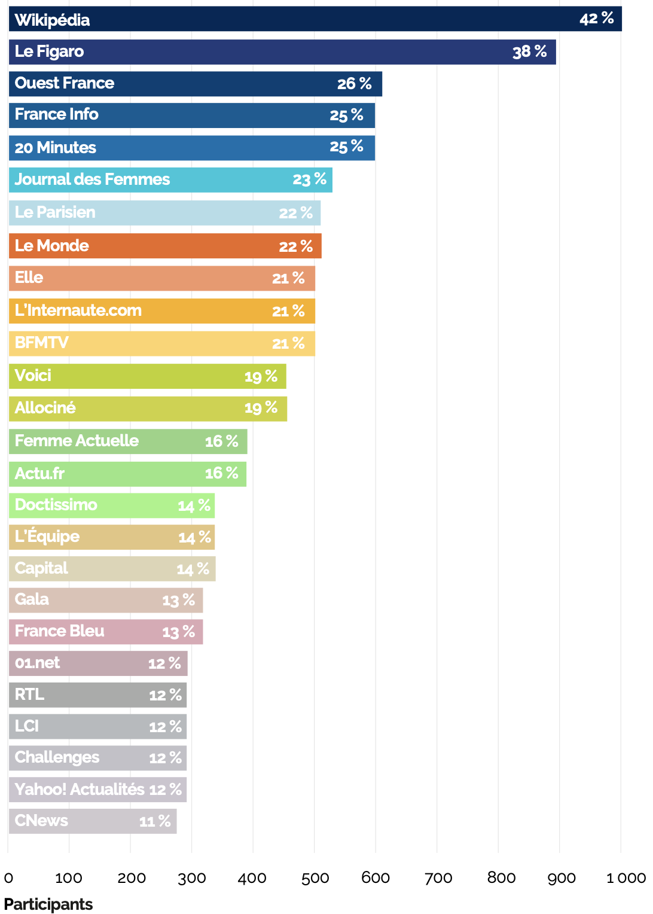
Results
Traditional media are appealing on the web
Ranking of leading information sources by number of participants having consulted them
The “top 26” online information sources that were consulted by the greatest number of participants largely consists of traditional media outlets
This “top 26” alone constitutes
40% of the time participants spent informing themselves online
Graph Reading: 38% of participants consulted the online source of Le Figaro at least once throughout the study’s 30-day period.

Slide 16
Results
Discrepancy between perceived and effective information behavior
Participants’ reported use of the Internet to inform themselves
– whether in terms of the nature of the sources they report consulting or in terms of the frequency with which they report doing so –
only weakly corresponds to their effective online information behavior, as measured by our study
Perceived information behavior
≠
Effective information behavior

Slide 17
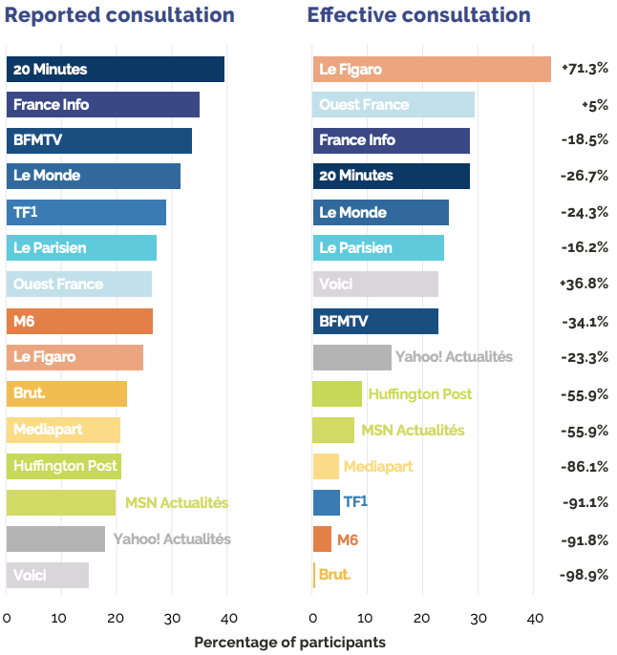
Results
Discrepancy between perceived and effective information behavior
Graph Reading:
39% of participants reported consulting 20 Minutes on the Internet to inform themselves during the study’s 30-day period.
28% of participants did effectively consult 20 Minutes at least once on the Internet during this period,
corresponding to a 26.7% decrease
Note:
The effective consultation of Brut is underestimated because this media is meant to be viewed directly on the personal “walls” or “feeds” of social network users, which could not be accounted for in our study.

Slide 18
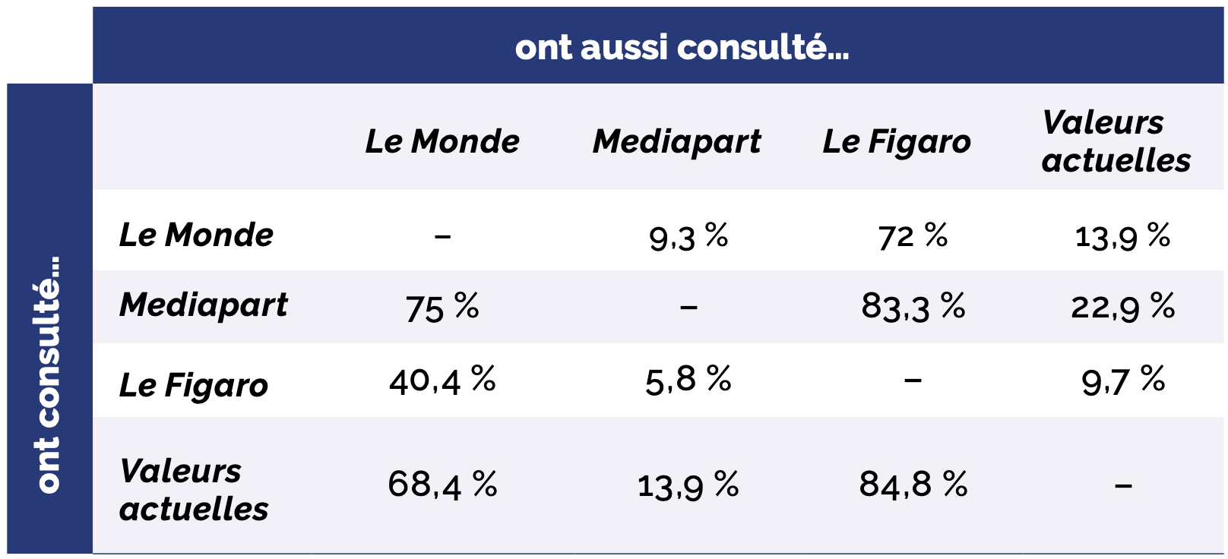
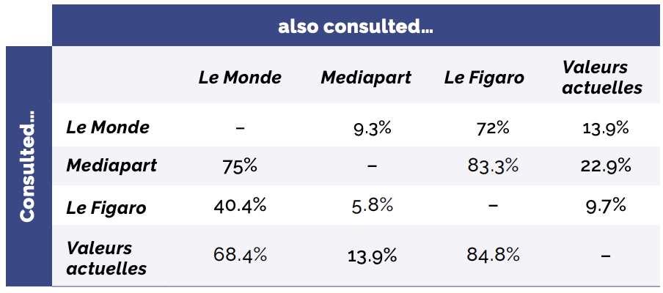
Results
The French do not seem to be enclosed in echo chambers
The participants in our study do not seem to be enclosed in echo chambers based on the supposed political orientation of information sources
A result consistent with those of the Fondation Descartes study on the “new political-media landscape in France”:
https://www.fondationdescartes.org/en/2020/11/visualization-of-the-new-political-media-landscape-in-france/

Slide 19
Results
Level of trust does not determine information behavior
Trust in a source
Consultation of a source
We observed only a very weak relationship between the online consultation of information sources and participants’ reported level of trust in these sources

Slide 20
Results
Exposure of the French to unreliable sources
39% of participants consulted at least one information source deemed unreliable throughout the study’s 30-day period
On average, these participants spent 11% of their online time dedicated to information on sources deemed unreliable.
Among all participants, 5% of connected time dedicated to information was spent on information sources deemed unreliable

Slide 21
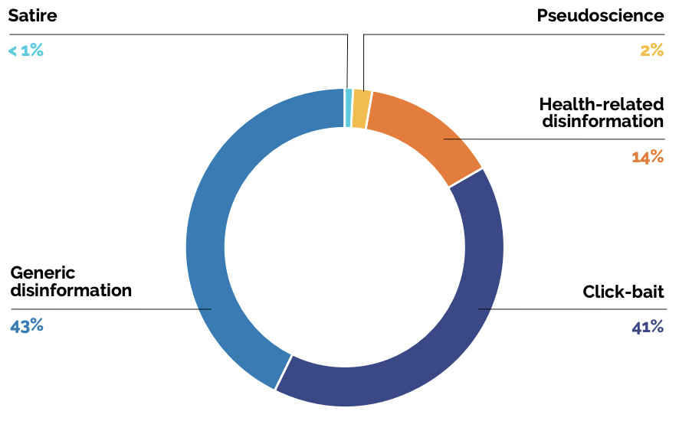
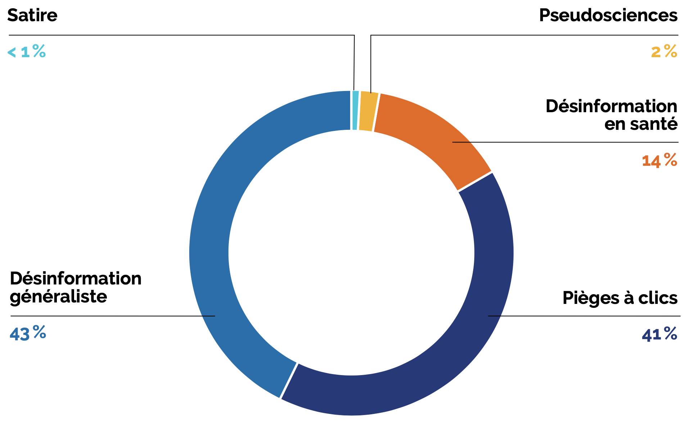
Results
Unreliable sources most visited by the French
Distribution of time spent on information sources deemed unreliable
1. Sources of generic disinformation
Sources that provide information and news content on principally social and political topics.
2. Sources of “click-bait”
Sources whose content is not intended to inform the reader, but solely to attract their attention in order to generate traffic on their page.
3. Sources of health-related disinformation

Slide 22
Results
Risk factors for exposure to generic disinformation
Are overrepresented among those who visited a source of generic disinformation at least once during the study period:
Men
Individuals who live alone
Individuals who report being more supportive of the Yellow Vests movement, or who self-identify as members of this movement
Individuals who report having a lower level of trust in institutions, the government and the media
Individuals who report being more interested by news information
Individuals who report informing themselves more on the Internet

Slide 23
Results
Risk factors for exposure to health-related disinformation
Are overrepresented among those who visited a source of health-related disinformation at least once during the study period:
Women
Inactive individuals, including retirees
Individuals aged 50 and over
Individuals with a tendency towards belief in conspiracy theories

Slide 24
Results
Risk factors for exposure to “click-bait”
Are overrepresented among those who consulted a source of “click-bait” at least once during the study period:
Individuals aged 65 and over
Inactive individuals, including retirees
Individuals with a lower level of education
Individuals with a lower household income level
Individuals who report informing themselves more on the Internet and via television

Slide 25
Key Takeaways
The online information market
In France, traditional media outlets remain the leaders of the online information market
However
Their role in editorializing news information is decreasing significantly, due to the “browsing” behavior of Internet users and the development of social networks
More than a third of our panel consulted sources deemed unreliable throughout the study period

Slide 26
Key Takeaways
Results out of phase with certain conventional ideas
Surveys on information behavior are insufficient
The French do spend more time consulting the media outlets that they report trusting most
The French do not seem to be enclosed in informational echo chambers
Exposure to disinformation is significant but generally limited

Slide 27
Perspectives
Projects of the Fondation Descartes
Conduct this study annually and expand on it
Extend this study to other European countries
Analyze the extent of disinformation on social networks by establishing partnerships with media outlets and platforms
Permanently monitor the structural evolutions of the information market and their impact on the integrity of public debate
Formulate, if necessary, public policy proposals – namely with regards to the fight against disinformation and the regulation of platforms

